Slide 1
Multidimensional Arrays in C
By nida munawar

Slide 2
Multiple-Subscripted Arrays
An array of arrays is called as multi dimensional array. In simple words, an array created with more than one dimension (size) is called as multi dimensional array. Multi dimensional array can be of two dimensional array or three dimensional array or four dimensional array... Most popular and commonly used multi dimensional array is two dimensional array. The 2-D arrays are used to store data in the form of table. We also use 2-D arrays to create mathematical matrices.

Slide 3
Multiple-Subscripted Arrays
Multiple subscripted arrays
Tables with rows and columns (m by n array)
Like matrices: specify row, then column
Column 0
Column 1
Column 2
Column 3
Row 0
a[ 0 ][ 0 ]
a[ 0 ][ 1 ]
a[ 0 ][ 2 ]
a[ 0 ][ 3 ]
Row 1
a[ 1 ][ 0 ]
a[ 1 ][ 1 ]
a[ 1 ][ 2 ]
a[ 1 ][ 3 ]
Row 2
a[ 2 ][ 0 ]
a[ 2 ][ 1 ]
a[ 2 ][ 2 ]
a[ 2 ][ 3 ]
Column subscript
Array name
Row subscript

Slide 4
Multiple-Subscripted Arrays (cont’d)
Initialization
int b[ 2 ][ 2 ] = { { 1, 2 }, { 3, 4 } };
Initializers grouped by row in braces
If not enough, unspecified elements set to zero
int b[ 2 ][ 2 ] = { { 1 }, { 3, 4 } };
Referencing elements
Specify row, then column
printf( "%d", b[ 0 ][ 1 ] );
1 2
3 4
1 0
3 4

Slide 5
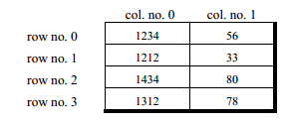
Multiple-Subscripted Arrays (cont’d)
The 2-D array arrangement is shown below.
Remember the counting of rows and columns begin with zero.

Slide 6

Multiple-Subscripted Arrays (cont’d)
Memory Map of a 2-Dimensional Array:
Let us reiterate the arrangement of array elements in a two-dimensional array of students, which contains roll nos. in one column and the marks in the other.
The arrangement of array elements of a two-dimensional array in memory is shown below:

Slide 7
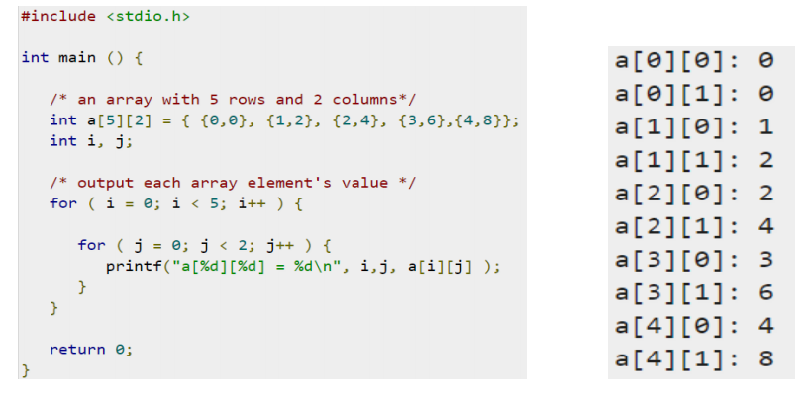
Multiple-Subscripted Arrays (cont’d)

Slide 8
#include <stdio.h>
int main() {
int r, c, a[100][100], b[100][100], sum[100][100], i, j;
printf("Enter the number of rows (between 1 and 100): ");
scanf("%d", &r);
printf("Enter the number of columns (between 1 and 100): ");
scanf("%d", &c);
printf("\nEnter elements of 1st matrix:\n");
for (i = 0; i < r; ++i)
for (j = 0; j < c; ++j) {
printf("Enter element a%d%d: ", i + 1, j + 1);
scanf("%d", &a[i][j]);
}
printf("Enter elements of 2nd matrix:\n");
for (i = 0; i < r; ++i)
for (j = 0; j < c; ++j) {
printf("Enter element b%d%d: ", i + 1, j + 1);
scanf("%d", &b[i][j]);
}
Example: Addition of two matrices

Slide 9
Multiple-Subscripted Arrays (cont’d)
// adding two matrices
for (i = 0; i < r; ++i)
for (j = 0; j < c; ++j) {
sum[i][j] = a[i][j] + b[i][j];
}
// printing the result
printf("\nSum of two matrices: \n");
for (i = 0; i < r; ++i){
for (j = 0; j < c; ++j) {
printf("%d ", sum[i][j]);
}
printf("\n");
}
return 0;
}
Example: Addition of two matrices

Slide 10
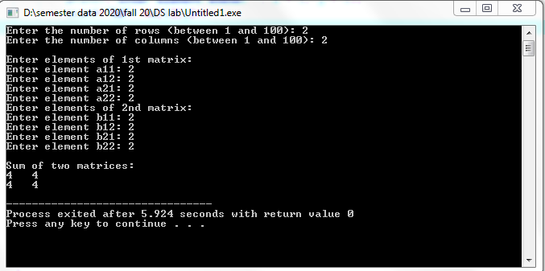

Slide 11
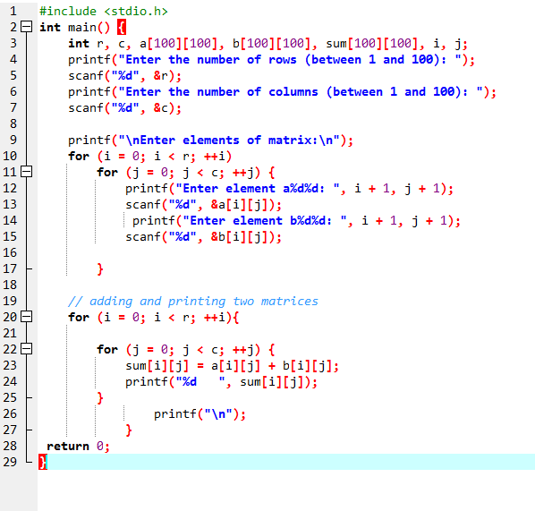
Summarized code

Slide 12
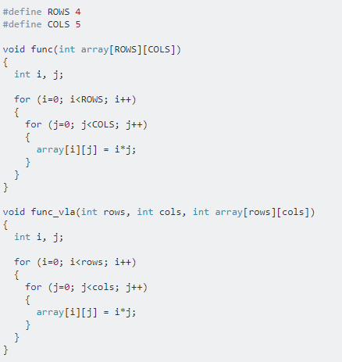
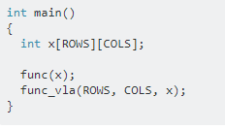
Multiple-Subscripted Arrays (cont’d)
Passing 2-D Array to Function

Slide 13
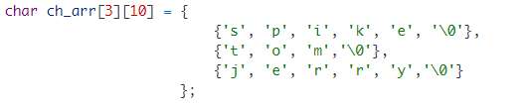
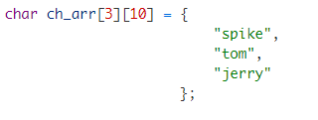
Array of Strings
A string is a 1-D array of characters, so an array of strings is a 2-D array of characters.
Just like we can create a 2-D array of int, float etc; we can also create a 2-D array of character
or array of strings. Here is how we can declare a 2-D array of characters.

Slide 14
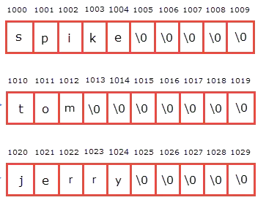
Array of Strings
In memory allocation:

Slide 15
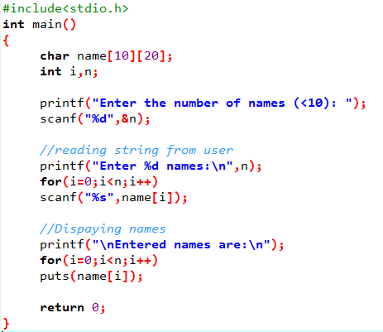
Array of Strings
In memory allocation:

Slide 16
